Slide 1
MOBILE COMPUTING
Prof Ashish Paliwal
Mobile Computing

Slide 2
Goal of wireless & mobile computing is “People and their machines should be able to access information and communicate with each other easily and securely, in any medium or combination of media to exchange voice, data, image, video, or multimedia at any time, anywhere, in a timely, cost-effective way.”
Prof Ashish Paliwal
Mobile Computing

Slide 3
Mobile computing is a generic term describing one's ability to use technology while moving, as opposed to portable computers, which are only practical for use while deployed in a fixed configuration.
Wearable computer
Personal digital assistant /Enterprise digital assistant
Smart phone
Carputer
UMPC
Pocket PC
Prof Ashish Paliwal
Mobile Computing

Slide 4
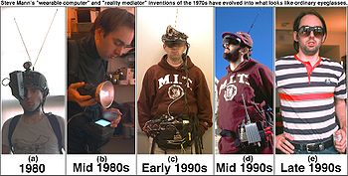
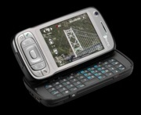
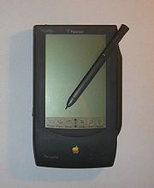
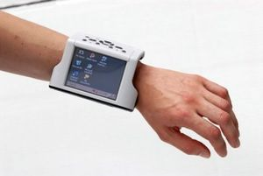
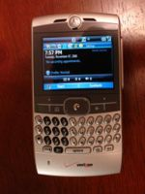
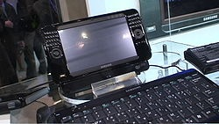
DIFFERNENT COMPUTING DEVICES
Prof Ashish Paliwal
Mobile Computing

Slide 5
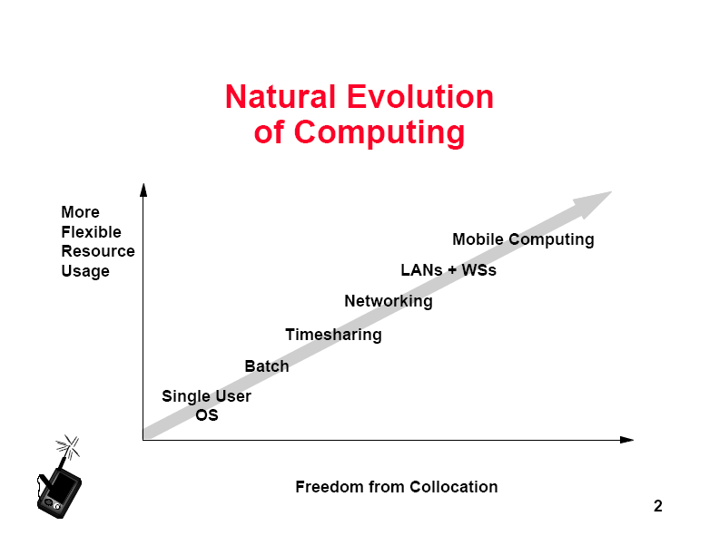
Prof Ashish Paliwal
Mobile Computing

Slide 6
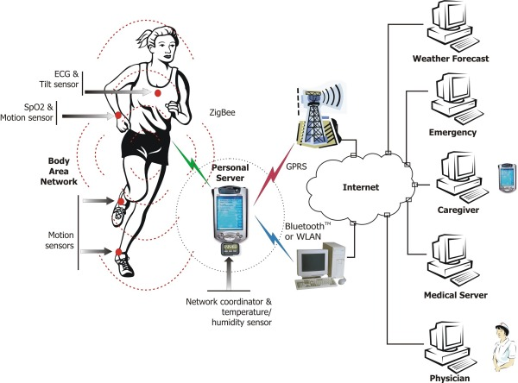
Prof Ashish Paliwal
Mobile Computing

Slide 7
Limitations of mobile computing
Insufficient bandwidth
Security standards
Power consumption & short battery lifetime
Transmission Interferences
limited capacities
Potential Health Hazards
Human Interface with devices
heterogeneity of fragmented networks
frequent disconnections
Prof Ashish Paliwal
Mobile Computing

Slide 8
Advantages
Improving the data collection process
Improving data accuracy
Reducing paperwork
Enforcing collection of more complete information
Facilitating collection of more useful information
Eliminating redundant data entry
Reducing administrative costs
Reducing billing errors
Prof Ashish Paliwal
Mobile Computing

Slide 9
Reducing data backlog
Improving information flow
Allowing faster adaptation to changing business conditions
Increasing responsiveness and customer satisfaction
Providing access to previously unavailable information
Prof Ashish Paliwal
Mobile Computing

Slide 10
QUALITY OF DATA
Mobile computing enables immediate validation of the data
It reduces the transcription error for survey like applications
Using networking, information can be made available in near real-time
Very fast turn around time from data collection to analysis and reporting. This can translate into significant cost saving.
Prof Ashish Paliwal
Mobile Computing

Slide 11
Wireless Networks
  Cellular networks
  Wireless LANs
  Satellite systems, …
Mobile Applications
  Client-Server adaptations
  Disconnected operations
  Mobile agents
  Data broadcasting
  Wireless application protocol
Other Issues
  Security
  Energy efficiency
  Impact of mobility on algorithms
Prof Ashish Paliwal
Mobile Computing

Slide 12
Wireless Networks
Need: Access computing and communication services, on the move
Infrastructure-based Networks
  traditional cellular systems (base station infrastructure)
Wireless LANs
  Infrared (IrDA) or radio links (Wavelan)
  very flexible within the reception area
  low bandwidth compared to wired networks (1-10 Mbit/s)
Ad hoc Networks
  useful when infrastructure not available, impractical, or expensive
  military applications, rescue, home networking
Prof Ashish Paliwal
Mobile Computing

Slide 13
Mobile Applications
Vehicles
  transmission of news, road condition etc
  ad-hoc network with near vehicles to prevent accidents
Emergencies
  early transmission of patient data to the hospital
  ad-hoc network in case of earthquakes, cyclones
  military ...
Travelling salesmen
  direct access to central customer files
  consistent databases for all agents
  mobile office
Prof Ashish Paliwal
Mobile Computing

Slide 14
Mobile Applications
Web access
  outdoor Internet access
  intelligent travel guide with up-to-date
  location dependent information
Location aware services
  find services in the local environment, e.g. printer
Information services
  stock quotes
  nearest cash ATM
Entertainment
  ad-hoc networks for multi user games
Prof Ashish Paliwal
Mobile Computing

Slide 15
Bluetooth
Short range (10m),moderate data rate (720kbps) for creating an ad-hoc network between personal devices
One master and upto 7 slaves
Master controls the transmission
schedules of all the devices
Avoid interference with other
Prof Ashish Paliwal
Mobile Computing

Slide 16
Portable Computing Devices
A Portable computer
-easily moved from place to place
- cannot be used while in transit, usually because it requires some "setting-up" and an AC power source.
-example: Osborne 1.
-also called a transportable or a luggable PC.
A Tablet PC
-lacks a keyboard
-also known as a non- convertible Tablet PC
-shaped like slate or a paper notebook
-features a touch screen with a stylus and handwriting recognition software.
-Tablets may not be best suited for applications requiring a physical keyboard for typing,
-carry out most tasks that an ordinary laptop would be able to perform.
Prof Ashish Paliwal
Mobile Computing

Slide 17
Portable Computing Devices
An Internet tablet is an Internet appliance in tablet form.
- can not replace a general purpose computer.
- Internet tablets typically feature an MP3 and video player, a web browser, a chat application & a picture viewer.
A Personal digital assistant (PDA) is a small, usually pocket-sized, computer with limited functionality.
- It is intended to supplement & to synchronize with a desktop computer,
- giving access to contacts, address book, notes, e-mail and other features.
An Ultra Mobile PC is a full-featured, PDA-sized computer running a general-purpose operating system.
A Smart phone is a PDA with an integrated cell phone functionality. Current smart phones have a wide range of features and installable applications.
Prof Ashish Paliwal
Mobile Computing

Slide 18
• Display Only
– InfoPad model: limited portable processing
– Constrained to operation within prepared infrastructure,
like a cordless phone
– Advantages with respect to power consumption, upgrade
path, lightweight, impact of lost/broken/stolen device
• Laptop Computer
– Thinkpad model: significant portable processing,
operates independently of wireless infrastructure
– Disadvantages: power consumption, expensive,
significant loss exposure, typically greater than 5 pounds
Prof Ashish Paliwal
Mobile Computing

Slide 19

Thank You
Prof Ashish Paliwal
Mobile Computing

